Slide 1

Security Challenges

Slide 2

Access control
is a method of guaranteeing that users are who they say they are and that they have the appropriate access to data.
Discretionary access control (DAC)
Mandatory access control (MAC)
Role Based Access Control (RBAC)
Keep Track
Secure Sensitive data
Reduce The risk
Access control is the selective restriction of access
to some kind of resource (a folder, a file, and a device).

Slide 3




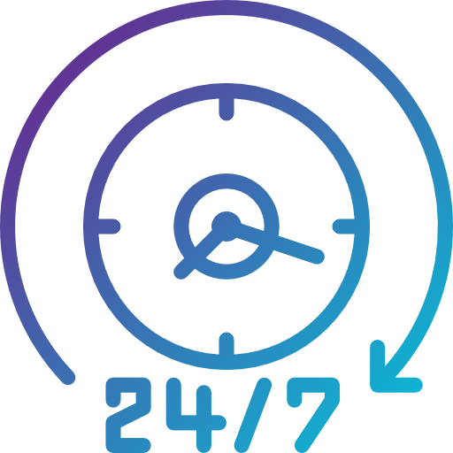
C
equivalent to privacy. Measures undertaken to ensure confidentiality that are designed to prevent sensitive information from reaching the wrong people
Data must be encrypted before it is outsourced, to protect it from malicious internal or external attacks.
Confidentiality
maintaining the accuracy, file permissions & AC.
ensure that data cannot be altered by unauthorized people
Protect the data from the unauthorized insert, update, or delete.
I
Integrity
maintaining all hardware, upgrades, communication bandwidth, maintaining the backup server
Data in the cloud should be accessible to its users. DOS
A
Availability
designed to guide policies for information security

Slide 4

Essential security
Insecurity
Internal Security
Separation of Duties
Least Privilege
no matter what you do, and how much money you spend, you will never have a 100 percent secure environment.
system is defended by multiple layers of security, each one protecting it from a particular type of attack.
the basic idea of this principle is that completely trusting people could be unsafe
any user, process, or system has all but only the permissions required to complete the assigned tasks.

Slide 5

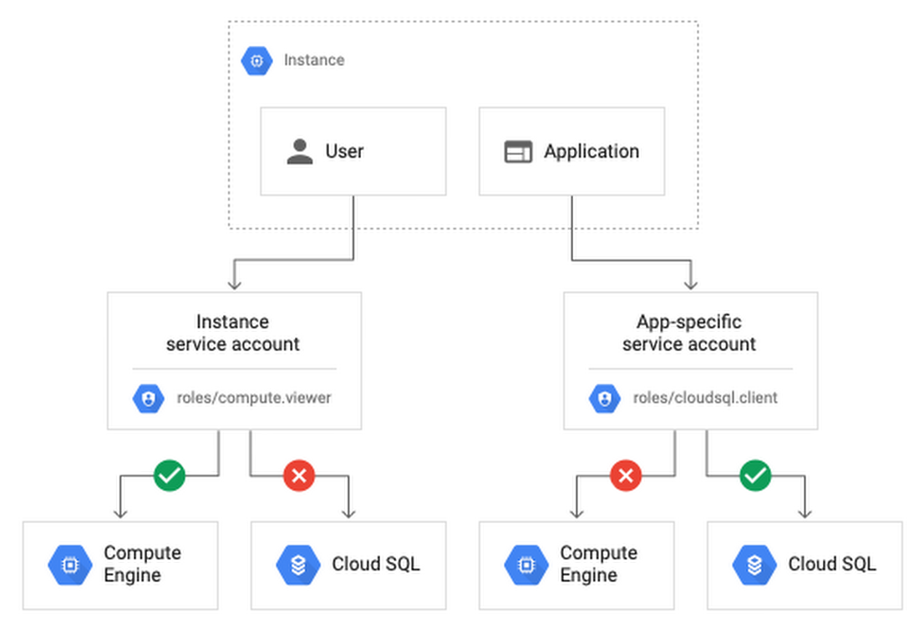
PO least privileges
allowing only enough access to perform the required job
any user, program, or process should have only the bare minimum privileges necessary to perform its function. E.g. a account created for pulling records from a database doesn’t need admin rights.
Advantage
Monitor and track all network activity, including individual logins, system changes, and access requests.
Identify and separate high-level system functions from lower-level functions.
narrows the scope of harm that can be caused by unwanted or unauthorized use of network privileges.

